Slide 1


Muhammad Usman Ali

Slide 2

Outline
Executive Summary
Introduction
Methodology
Results
Conclusion
Appendix

Slide 3
Executive Summary
In this capstone project, we will predict if the SpaceX Falcon 9 first stage will land successfully using several machine learning classification algorithms.
The main steps in this project include:
Data collection, wrangling, and formatting
Exploratory data analysis
Interactive data visualization
Machine learning prediction
Our graphs show that some features of the rocket launches have a correlation with the outcome of the launches, i.e., success or failure.
It is also concluded that decision tree may be the best machine learning algorithm to predict if the Falcon 9 first stage will land successfully

Slide 4
Introduction

Slide 5

Section 1

Slide 6
Methodology
The overall methodology includes:
Data collection, wrangling, and formatting, using:
SpaceX API
Web scraping
Exploratory data analysis (EDA), using:
Pandas and NumPy
SQL
Data visualization, using:
Matplotlib and Seaborn
Folium
Dash
Machine learning prediction, using
Logistic regression
Support vector machine (SVM)
Decision tree
K-nearest neighbors (KNN)

Slide 7
Data Collection
Web scraping
The data is scraped from https://en.wikipedia.org/w/index.php?title=List_of_Falcon_9_and_Falcon_Heavy_launches&oldid=1027686922
The website contains only the data about Falcon 9 launches.
We end up with 121 rows or instances and 11 columns or features. The picture below shows the first few rows of the data

Slide 8
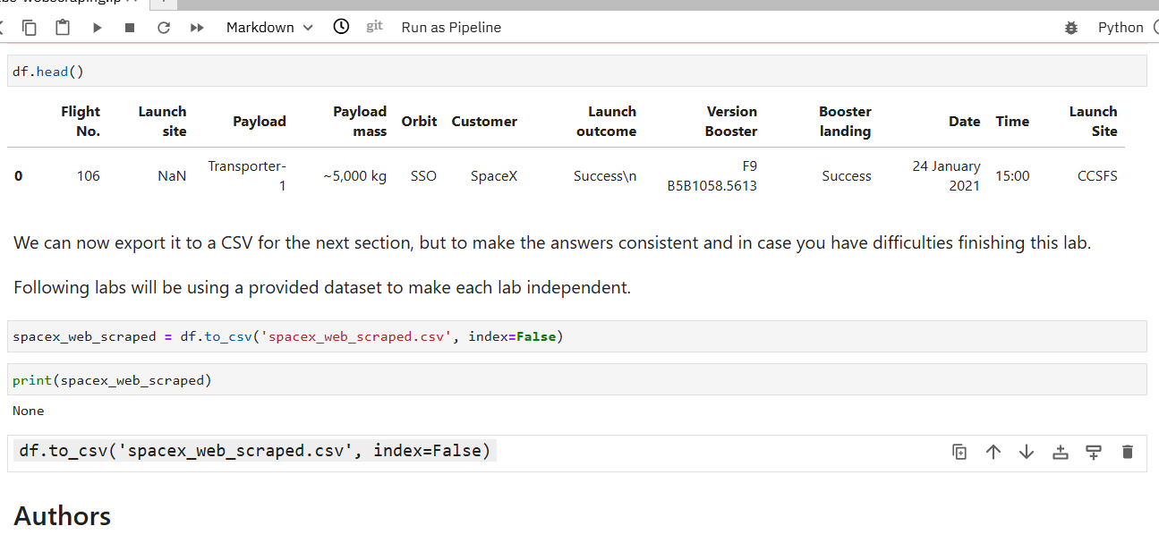
Data Collection – SpaceX API
The API used is https://api.spacexdata.com/v4/rockets/.
The API provides data about many types of rocket launches done by SpaceX, the data is therefore filtered to include only Falcon 9 launches.
Every missing value in the data is replaced the mean the column that the missing value belongs to.
https://github.com/usmanali9999/Applied-Data-Science-Capstone/blob/main/02_webscraping.ipynb

Slide 9

Data Collection - Scraping
Web scraping
The data is scraped from https://en.wikipedia.org/w/index.php?title=List_of_Falcon_9_and_Falcon_Heavy_launches&oldid=1027686922
The website contains only the data about Falcon 9 launches.
https://github.com/usmanali9999/Applied-Data-Science-Capstone/blob/main/02_webscraping.ipynb

Slide 10
Data Wrangling
The data is later processed so that there are no missing entries and categorical features are encoded using one-hot encoding.
An extra column called ‘Class’ is also added to the data frame. The column ‘Class’ contains 0 if a given launch is failed and 1 if it is successful.
In the end, we end up with 90 rows or instances and 83 columns or features.
https://github.com/usmanali9999/Applied-Data-Science-Capstone/blob/main/03_Data%20wrangling.ipynb

Slide 11
EDA with Data Visualization
Matplotlib and Seaborn
Functions from the Matplotlib and Seaborn libraries are used to visualize the data through scatterplots, bar charts, and line charts.
The plots and charts are used to understand more about the relationships between several features, such as:
The relationship between flight number and launch site
The relationship between payload mass and launch site
The relationship between success rate and orbit type
https://github.com/usmanali9999/Applied-Data-Science-Capstone/blob/main/05_edadataviz.ipynb

Slide 12
EDA with SQL
SQL
The data is queried using SQL to answer several questions about the data such as:
The names of the unique launch sites in the space mission
The total payload mass carried by boosters launched by NASA (CRS)
The average payload mass carried by booster version F9 v1.1
https://github.com/usmanali9999/Applied-Data-Science-Capstone/blob/main/04-eda-with-sql.ipynb

Slide 13
Build an Interactive Map with Folium
Folium
Functions from the Folium libraries are used to visualize the data through interactive maps.
The Folium library is used to:
Mark all launch sites on a map
Mark the succeeded launches and failed launches for each site on the map
Mark the distances between a launch site to its proximities such as the nearest city, railway, or highway
https://github.com/usmanali9999/Applied-Data-Science-Capstone/blob/main/06_launch_site_location.ipynb

Slide 14
Build a Dashboard with Plotly Dash
Dash
Functions from Dash are used to generate an interactive site where we can toggle the input using a dropdown menu and a range slider.
Using a pie chart and a scatterplot, the interactive site shows:
The total success launches from each launch site
The correlation between payload mass and mission outcome (success or failure) for each launch site
https://github.com/usmanali9999/Applied-Data-Science-Capstone/blob/main/07-dashapp.py

Slide 15
Predictive Analysis (Classification)
Functions from the Scikit-learn library are used to create our machine learning models.
The machine learning prediction phase include the following steps:
Standardizing the data
Splitting the data into training and test data
Creating machine learning models, which include:
Logistic regression
Support vector machine (SVM)
Decision tree
K nearest neighbors (KNN)
Find the best combination of hyperparameters for each model
Evaluate the models based on their accuracy scores and confusion matrix
https://github.com/usmanali9999/Applied-Data-Science-Capstone/blob/main/08_Machine_Learning_Prediction.ipynb

Slide 16
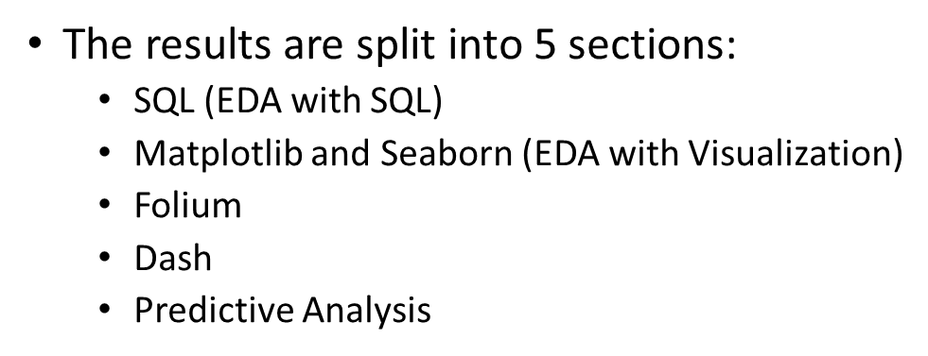
Results

Slide 17

Section 2

Slide 18
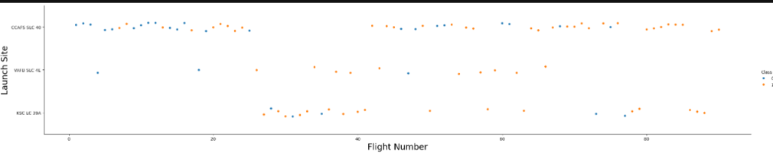
Flight Number vs. Launch Site

Slide 19
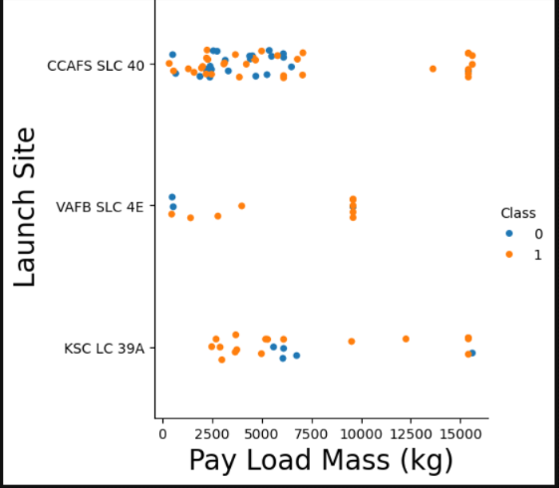
Payload vs. Launch Site
The relationship between payload mass and launch site

Slide 20
Success Rate vs. Orbit Type
Show a bar chart for the success rate of each orbit type
Show the screenshot of the scatter plot with explanations

Slide 21
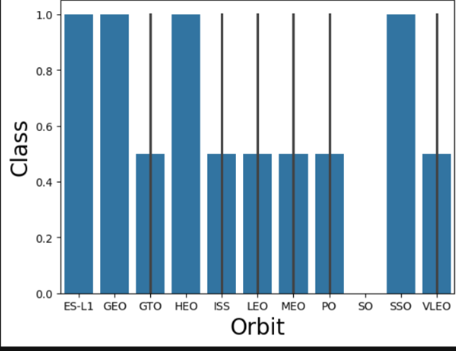
Flight Number vs. Orbit Type
The relationship between success rate and orbit type

Slide 22
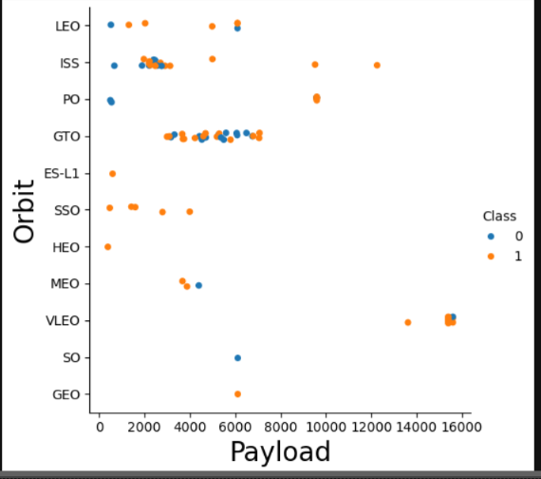
Payload vs. Orbit Type
The relationship between payload mass and orbit type

Slide 23
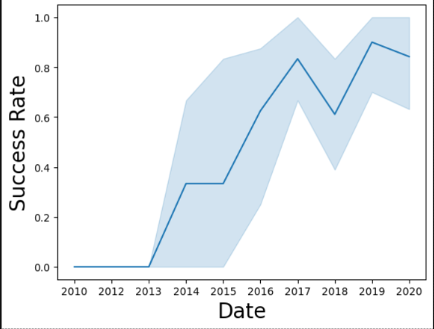
Launch Success Yearly Trend
The launch success yearly trend

Slide 24
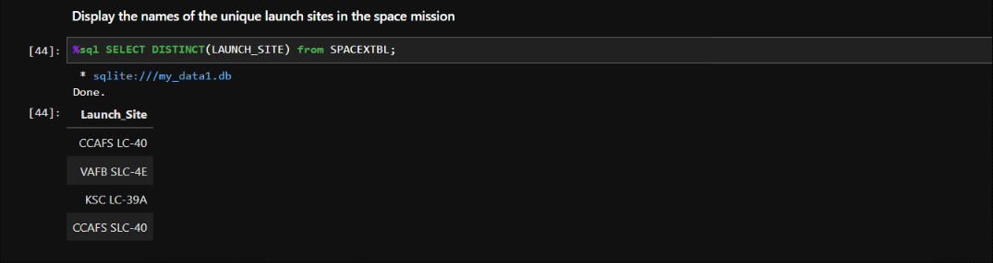
All Launch Site Names
The names of the unique launch sites in the space mission

Slide 25
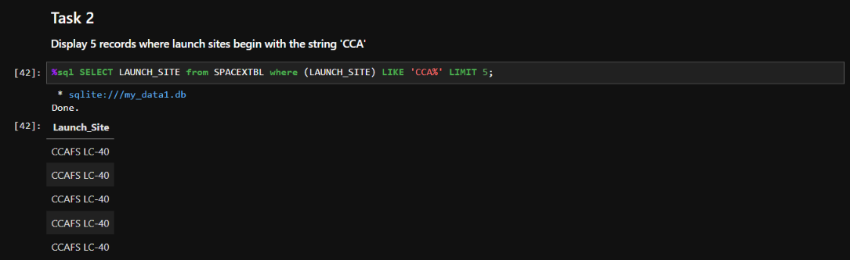
Launch Site Names Begin with 'CCA'
5 records where launch sites begin with ‘CCA’

Slide 26
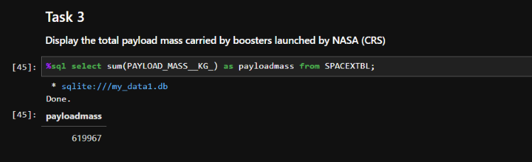
Total Payload Mass
The total payload mass carried by boosters launched by NASA (CRS)

Slide 27
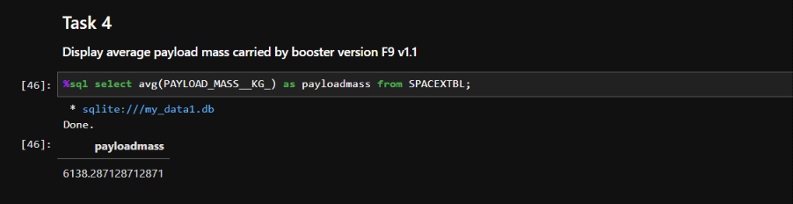
Average Payload Mass by F9 v1.1
The average payload mass carried by booster version F9 v1.1

Slide 28
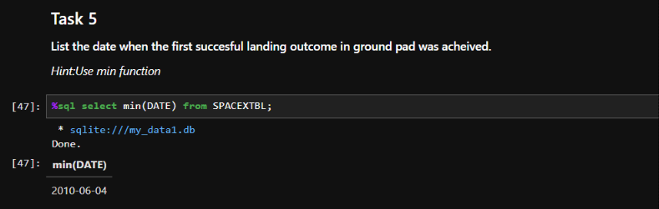
First Successful Ground Landing Date
The date when the first successful landing outcome in ground pad was achieved

Slide 29
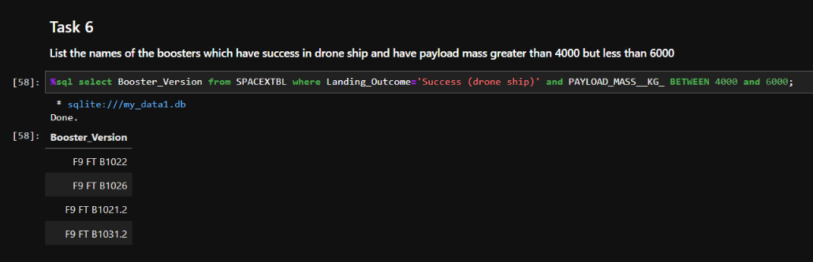
Successful Drone Ship Landing with Payload between 4000 and 6000
The names of the boosters which have success in drone ship and have payload mass greater than 4000 but less than 6000

Slide 30
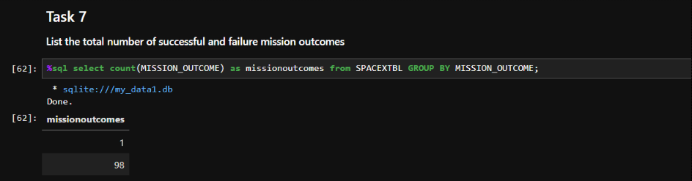
Total Number of Successful and Failure Mission Outcomes
The total number of successful and failure mission outcomes

Slide 31
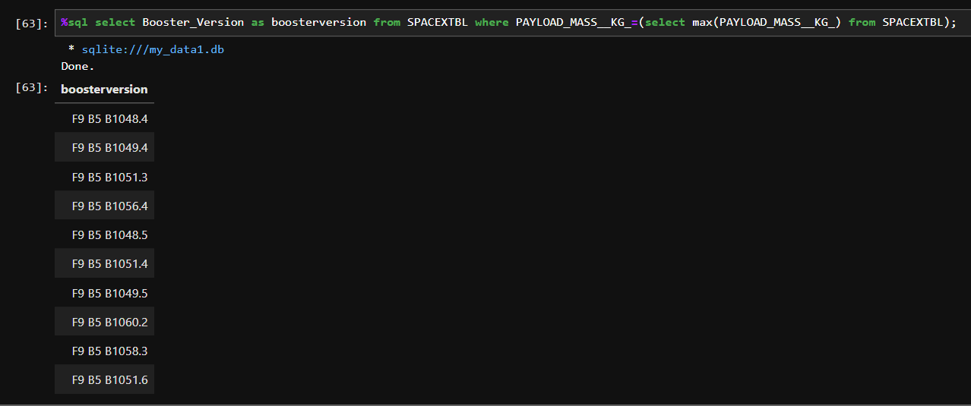
Boosters Carried Maximum Payload
The names of the booster versions which have carried the maximum payload mass

Slide 32
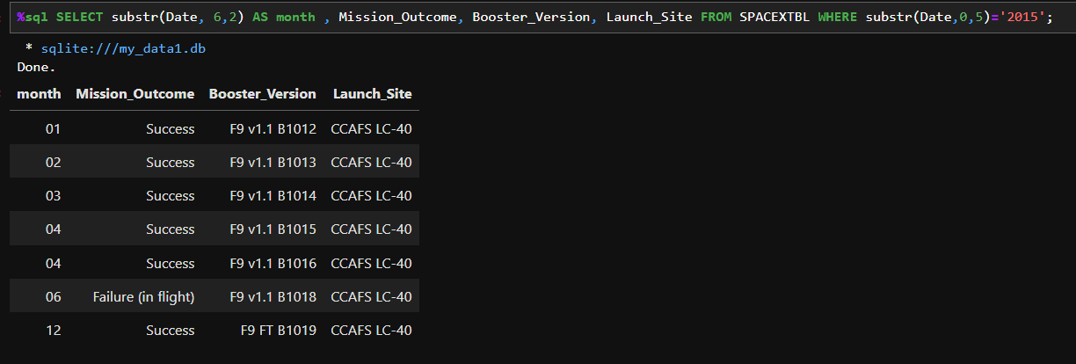
2015 Launch Records
The failed landing outcomes in drone ship, their booster versions, and launch site names for in year 2015

Slide 33
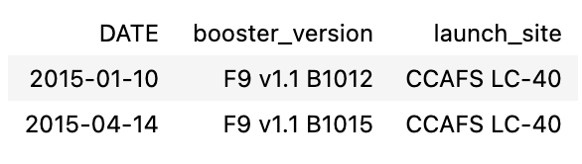
Rank Landing Outcomes Between 2010-06-04 and 2017-03-20
The count of landing outcomes between the date 2010-06-04 and 2017-03-20, in descending order

Slide 34

Section 3

Slide 35
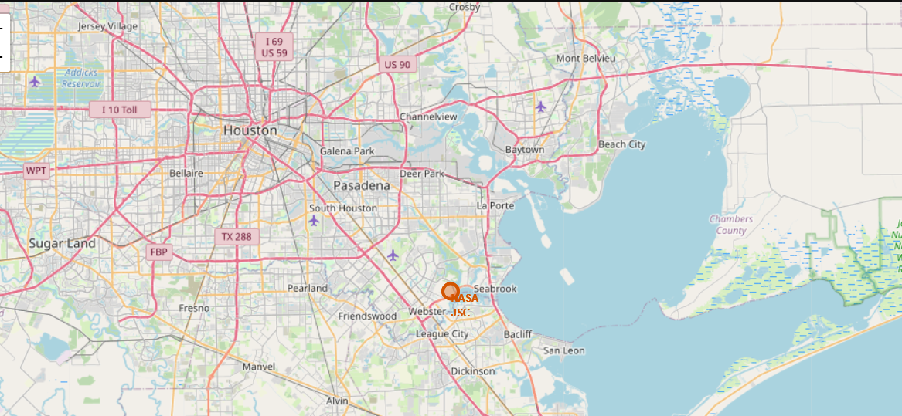
<Folium Map Screenshot 1>
All launch sites on map

Slide 36
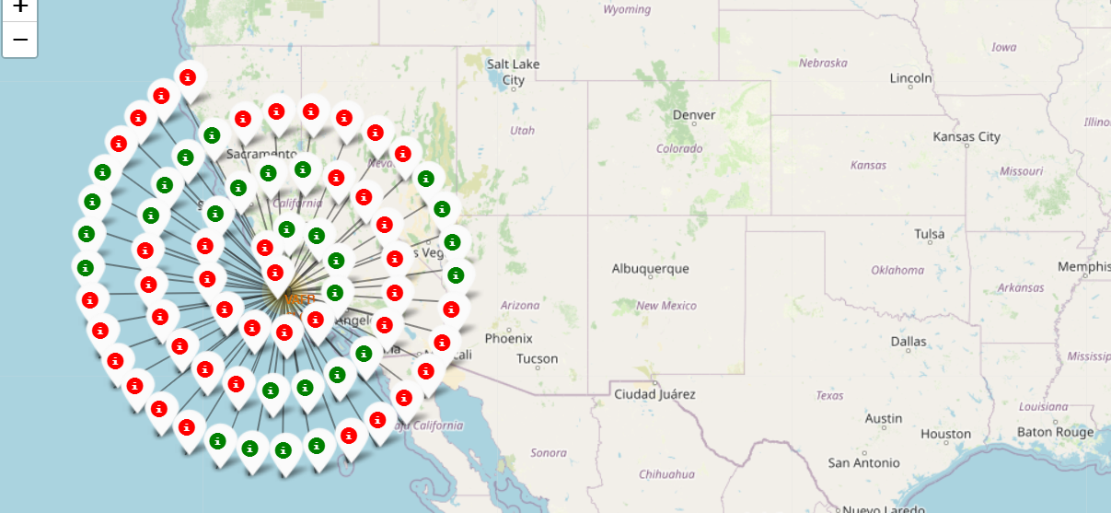
<Folium Map Screenshot 2>
The succeeded launches and failed launches for each site on map
If we zoom in on one of the launch site, we can see green and red tags. Each green tag represents a successful launch while each red tag represents a failed launch

Slide 37
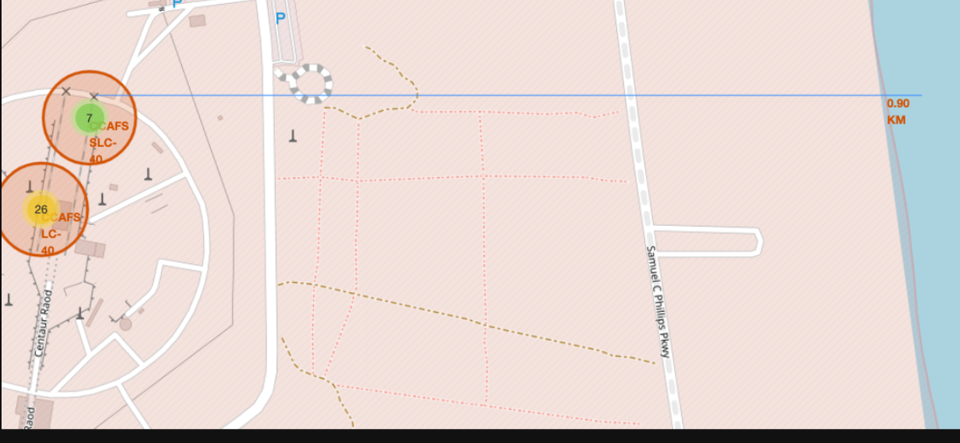
<Folium Map Screenshot 3>
The distances between a launch site to its proximities such as the nearest city, railway, or highway

Slide 38

Section 4

Slide 39
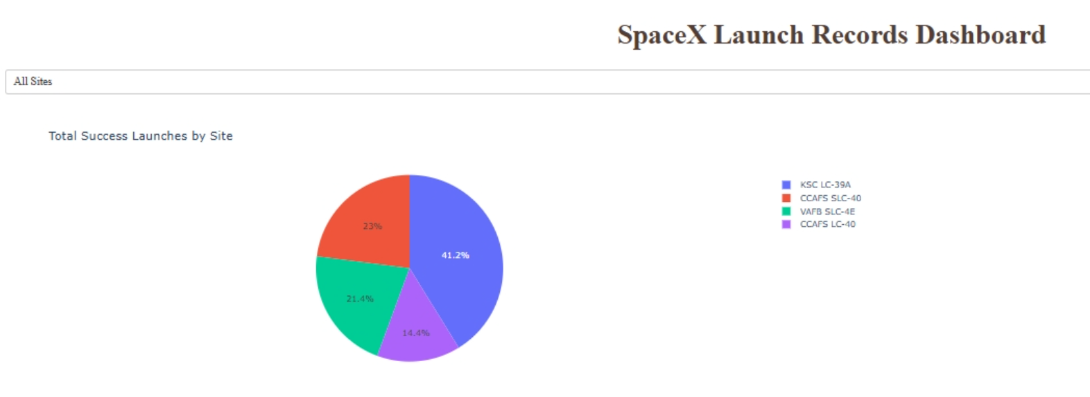
launch success count for all sites
The screenshot below shows the launch success count for all sites, in a piechart

Slide 40
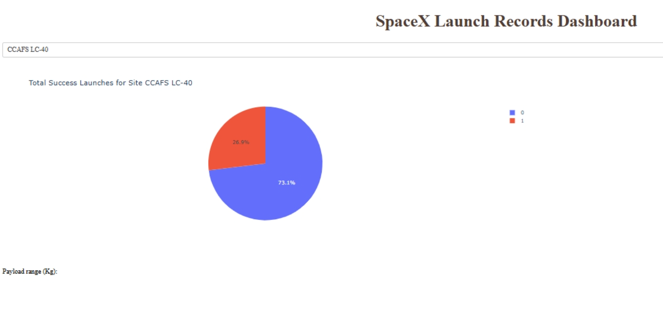
pie chart when launch site CCAFS LC-40
The picture below shows a pie chart when launch site CCAFS LC-40 is chosen.
0 represents failed launches while 1 represents successful launches. We can see that 73.1% of launches done at CCAFS LC-40 are failed launches.

Slide 41
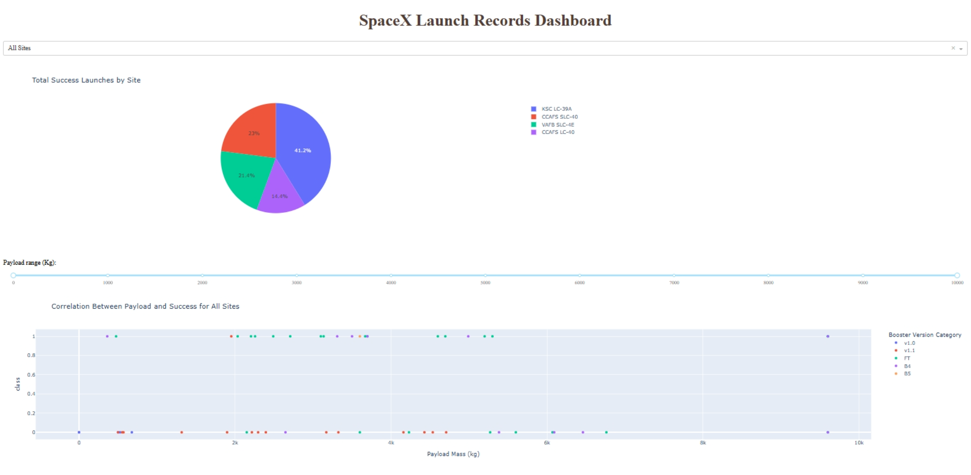
Screenshot for all sites
Show screenshots of Payload vs. Launch Outcome scatter plot for all sites

Slide 42

Section 5

Slide 43
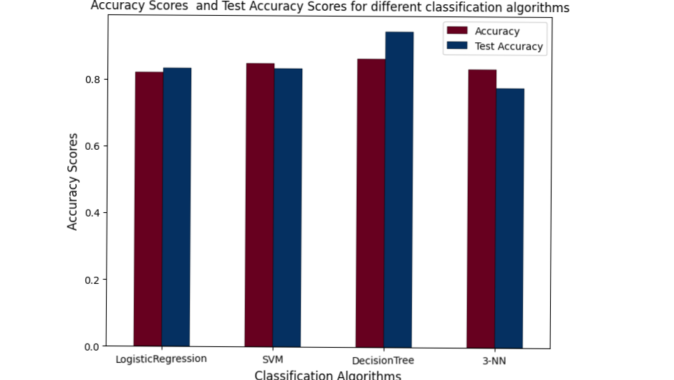
Classification Accuracy

Slide 44
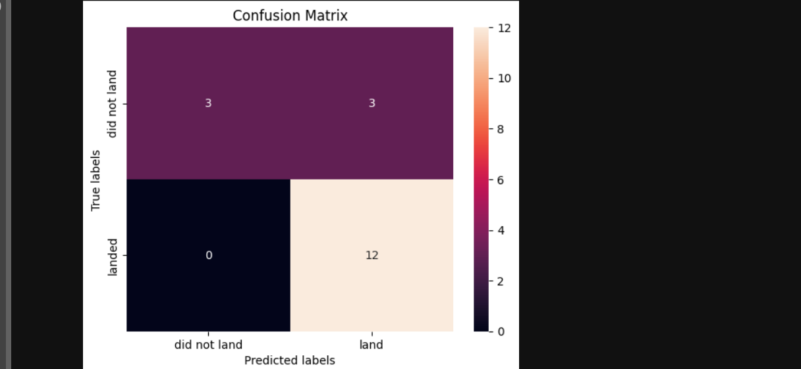
Confusion Matrix

Slide 45
Conclusions
In this project, we try to predict if the first stage of a given Falcon 9 launch will land in order to determine the cost of a launch.
Each feature of a Falcon 9 launch, such as its payload mass or orbit type, may affect the mission outcome in a certain way.
Several machine learning algorithms are employed to learn the patterns of past Falcon 9 launch data to produce predictive models that can be used to predict the outcome of a Falcon 9 launch.
The predictive model produced by decision tree algorithm performed the best among the 4 machine learning algorithms employed.

Slide 46


